Slide 1

D26010, D26058: ADF Sentinel
Agentic workflow for assay releases and AI-assisted ADF development testing
2026 CSD AI Hackathon
Yan Zhu, Jin Li, Chao Wang,
Eun Ji Kim, Jasmine Patil, Chenxi Chen
Notes:
Sources: /Users/chao.wang/workspace/csd-hkt-ADF/README.md
/Users/chao.wang/workspace/csd-hkt-ADF/docs/01-vision.md

Slide 2
Disclaimer
Project Timeline & Hackathon Contribution
Project initiated
3 Nov 2026 – 5 Nov 2026
Development before the hackathon
0 days. Existing ADF documents, test cases, Jira requirements, technical references and datasets supplied the starting knowledge.
Work during the 2-day hackathon
AI-assisted ADF Bundling -- Requirements parser, developing changes, repository changes, ADF generation, ADF import, ADF run completion, and the evidence dashboard.
AI-assisted ADF Dev Testing -- Built reusable automation for ADF import, sample setup and run launching, sanity-testing framework linking requirements to checks, evidence and reports.
2
Proprietary & Confidential | 2026 CSD AI Hackathon | 5-November-2026
Notes:
Template-required disclosure: project initiation Nov 3, 2026; pre-hackathon project development zero days; existing documentation and test assets are prior inputs, not pre-existing project development. Work during Nov 3–4 includes reusable agents, case adaptation, launch integration, execution evidence and review. This follows the user-confirmed timeline.
Sources:
/Users/chenxi.chen/Library/CloudStorage/OneDrive-ThermoFisherScientific/Projects/MyProjects/Hackathon2026/CSD_QA_scripts/Hackathon2026_ADF_sanity/sanity_testing/README.md
/Users/chenxi.chen/Library/CloudStorage/OneDrive-ThermoFisherScientific/Projects/MyProjects/Hackathon2026/CSD_QA_scripts/Hackathon2026_ADF_sanity/sample_run_launch/README.md

Slide 3

Collaboration
Gathered internal VOC from R&D, V&V, and program/product management to understand frustrations with ADF release delays.
Partnered with Molecular Biology, Systems, Bioinformatics, Software teams, and QA to build a prototype for AI-assisted ADF bundling and sanity testing.
Continued cross-functional collaboration will support prototype validation and refinement to streamline AI-assisted ADF bundling and sanity testing and reduce release delays.

Slide 4
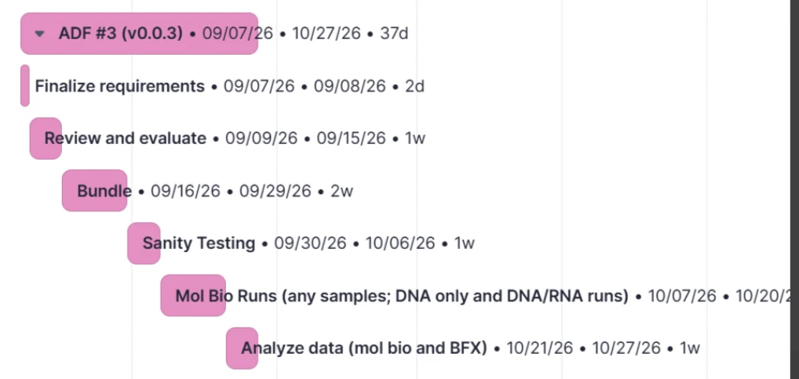
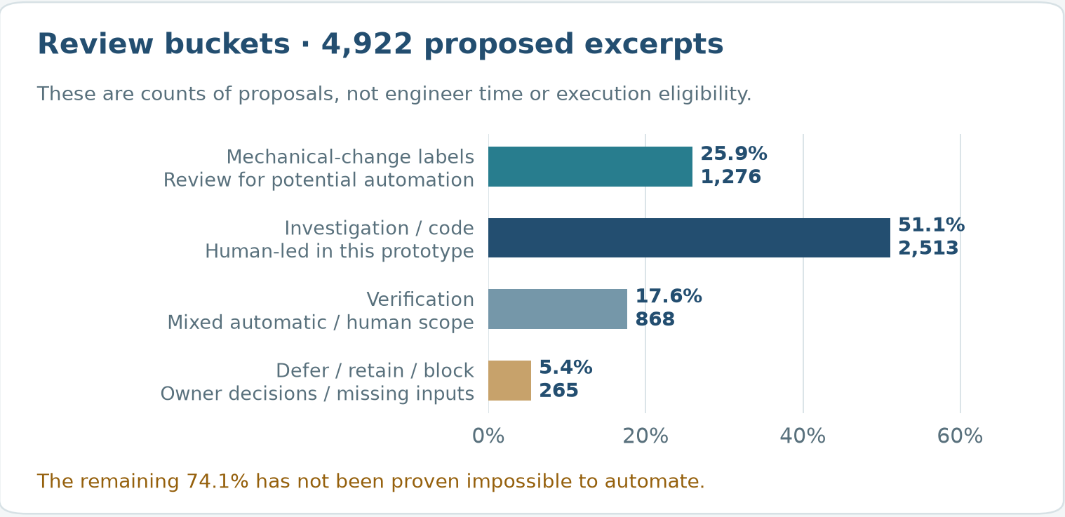
Problem and Motivation
Problem
Lengthy ADF bundling and sanity testing delay product launches.
Complex ADF requirements span repositories and dependencies, requiring manual investigation.
Manual troubleshooting and scattered evidence hinder release repeatability and review.

Slide 5
Solution and Impact
AI-assisted development testing
Requirements interpretation and feature development
Automatic ADF bundling
Deployment and evidence testing
4 weeks (maximum)
1 day*
(run AI Agent)
*requires human review
Impact
Keep projects and product launches on schedule.
Accelerate product development cycle through faster ADF bundling and sanity testing.
Reduce manual effort in troubleshooting and release preparation.

Slide 6
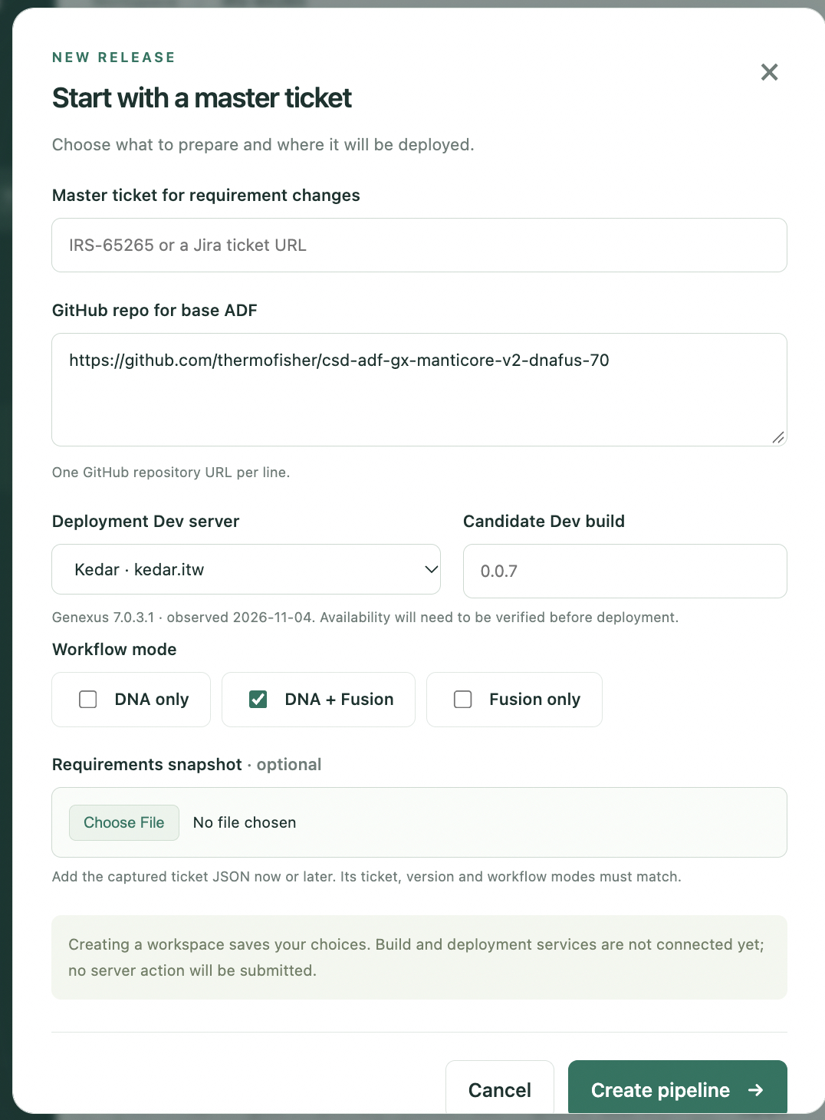
Demo: Master Ticket and target ADF – ADF Development
Enter the master ticket for requirements
Enter the GitHub repo for existed base ADF
Select the target Dev server to deploy the ADF – testing.
Set the ADF dev-build version and workflow mode.
The local workspace persists the inputs.
Create pipeline starts the agents.
Notes:
Sources: /Users/chao.wang/workspace/csd-hkt-ADF/docs/19-web-interface.md
/Users/chao.wang/workspace/csd-hkt-ADF/codex/handoffs/evidence/2026-11-04/web/new-pipeline.png

Slide 7
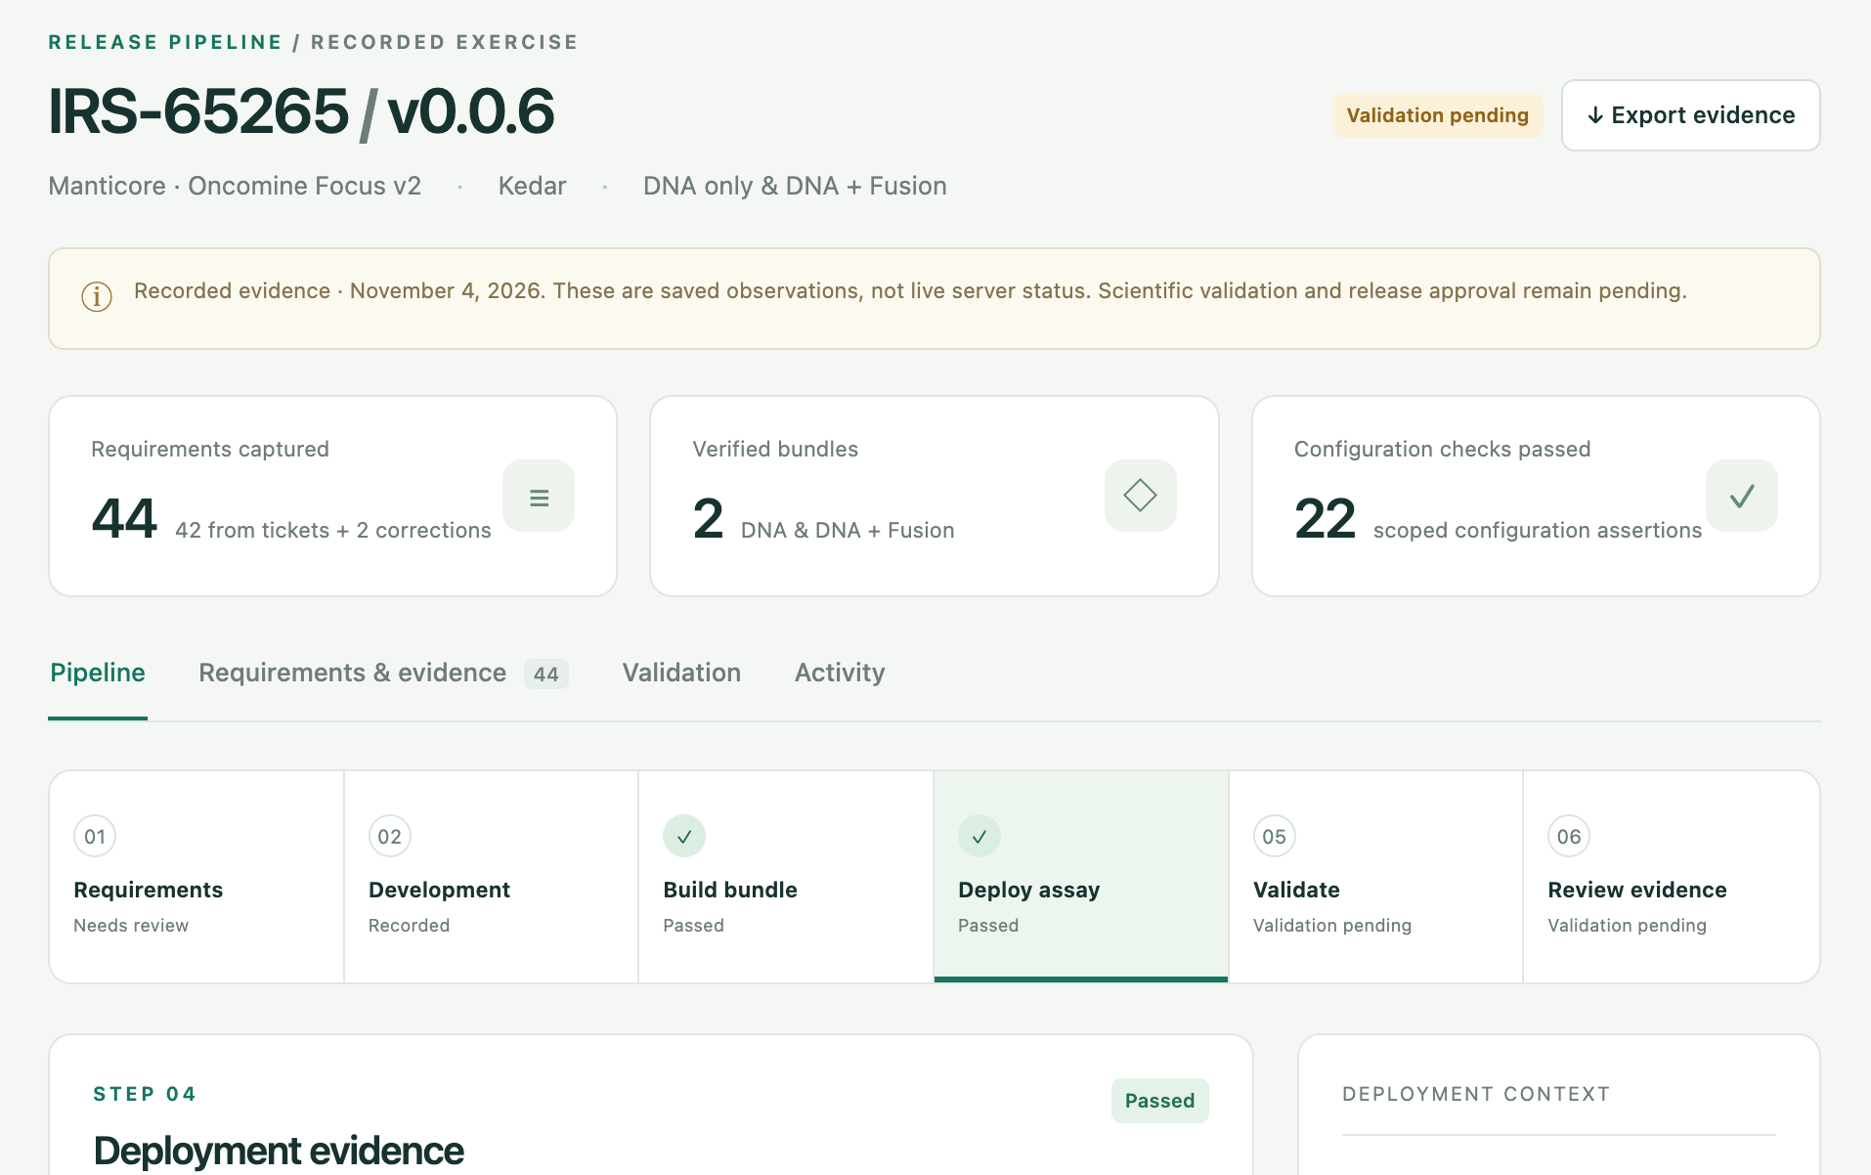
End to End pipeline – ADF Development
44 required changes captured and made.
2 ADFs generated, deployed and tested.
Testing runs launched, validation and captured screen shots.
The whole pipeline took about 5 hours.

Slide 8
Problem, Motivation and Business Impact – ADF testing
Goal: verify ADF requirements while reducing time and manual dev testing
Current execution automation
SQA performs
manual dev testing
SQA provides
expected results
Automation
replays test cases
AI-assisted development testing
Jira + approved
prior knowledge
AI derives expectations
and relevant checks
Evidence + reviewed
test case updates
Business value: faster ADF review and case maintenance across CSD releases.
3
Proprietary & Confidential | 2026 CSD AI Hackathon | 5-November-2026
Notes:
Template coverage: problem and relevance to CSD/NGS workflows, appropriate role of AI, business impact and AI transformation. The comparison describes the user’s current SQA workflow, not every form of test automation. The intended assistant helps perform the development reasoning before fixed execution automation can replay manually established cases. Expected results must come from approved requirements and independent references, never from candidate observations. Time savings are target estimates on the Conclusions slide, not a controlled benchmark. This supports the theme Invent Boldly. Build AI for Everyone by making reusable development knowledge available across ADF releases.
Sources:
/Users/chenxi.chen/Library/CloudStorage/OneDrive-ThermoFisherScientific/Projects/MyProjects/Hackathon2026/CSD_QA_scripts/Hackathon2026_ADF_sanity/sanity_testing/docs/architecture.md
/Users/chenxi.chen/Library/CloudStorage/OneDrive-ThermoFisherScientific/Projects/MyProjects/Hackathon2026/CSD_QA_scripts/Hackathon2026_ADF_sanity/sanity_testing/docs/future-adf-reviews.md

Slide 9
Method and Materials - ADF Testing
Technical Execution & Validation, Scalability & Reusability
Base test cases + Jira lineage
Confluence
Versioned knowledge base
Approved rules, mappings and sources
Interpret Jira
Select or add
relevant checks
Execute checks
Compare evidence
Report findings
Update test case drafts
AI understands requirements.
Prior test cases and approved knowledge guide sample type / dataset selection and run launch.
AI reasoning + deterministic Python checks + expert review
5
Proprietary & Confidential | 2026 CSD AI Hackathon | 5-November-2026
Notes:
Template coverage: method, models/algorithms, datasets, validation, responsible AI, scalability and reuse. The project combines Codex-assisted reasoning with deterministic Python agents. Sources are Jira and base lineage, base/target cases and attachments, captured Confluence development/QC guidance and approved fixtures. This is a reusable external knowledge base, not model fine-tuning. Current deterministic checks, curated profiles, mappings and a compact knowledge pack exist. Local bounded keyword retrieval and new-ticket preparation are now implemented. Automatic Jira ingestion and end-to-end orchestration remain future work. The pack persists user corrections, source precedence, correct case references, blocked acceptance gaps, QC-simulation procedure pointers and hashes. Routine deterministic comparisons do not need model calls. Future reviews still load a small index/relevant excerpts and refresh changed sources; zero tokens or universal automatic memory are not promised. Explainability uses expected/observed comparisons. Reproducibility and auditability use versioned profiles, run identities and evidence hashes. Expert review approves new expectations. Fresh observations, fixture qualification, simulation labeling and restoration rules prevent false PASS.
Sources:
/Users/chenxi.chen/Library/CloudStorage/OneDrive-ThermoFisherScientific/Projects/MyProjects/Hackathon2026/CSD_QA_scripts/Hackathon2026_ADF_sanity/sanity_testing/docs/architecture.md
/Users/chenxi.chen/Library/CloudStorage/OneDrive-ThermoFisherScientific/Projects/MyProjects/Hackathon2026/CSD_QA_scripts/Hackathon2026_ADF_sanity/sanity_testing/docs/live-workflow.md
/Users/chenxi.chen/Library/CloudStorage/OneDrive-ThermoFisherScientific/Projects/MyProjects/Hackathon2026/CSD_QA_scripts/Hackathon2026_ADF_sanity/sanity_testing/knowledge/ivdr-3.0.0/README.md
/Users/chenxi.chen/Library/CloudStorage/OneDrive-ThermoFisherScientific/Projects/MyProjects/Hackathon2026/CSD_QA_scripts/Hackathon2026_ADF_sanity/sanity_testing/knowledge/ivdr-3.0.0/decisions.json
Workflow clarification: AI interprets requirements using prior test-case guidance and approved knowledge, creates application sample records with the appropriate tissue type, selects qualified raw datasets or BAM fixtures carrying the independently expected positive calls, and triggers runs through the launch components. Sample creation refers to application records, not physical specimens. Tissue metadata alone does not establish a positive fixture. New ADFs still require reviewed profiles, suitable fixtures and configured access. The prototype results below use existing-run evidence and do not claim fresh sample creation or run launch during that review.
Sources:
/Users/chenxi.chen/Library/CloudStorage/OneDrive-ThermoFisherScientific/Projects/MyProjects/Hackathon2026/CSD_QA_scripts/Hackathon2026_ADF_sanity/sample_run_launch/README.md
/Users/chenxi.chen/Library/CloudStorage/OneDrive-ThermoFisherScientific/Projects/MyProjects/Hackathon2026/CSD_QA_scripts/Hackathon2026_ADF_sanity/sanity_testing/docs/live-workflow.md

Slide 10
Knowledge Reuse for a New Jira
A versioned catalog stores checking recipes, expert decisions and source links.
The agent retrieves relevant guidance, then verifies the current ADF.
Example Jira: “Update the VNS version”
01
02
03
04
Read current sources
Find saved guidance
Collect run evidence
Compare and report
Get the expected version
from the new Jira and
approved references.
Retrieve TC060’s recipe
and the Python version
collector.
Read installed and
executed versions from
the current ADF run.
Compare the versions.
Link the verdict and
evidence to the Jira.
The catalog reuses checking knowledge while each review collects fresh evidence.
Current retrieval uses local keyword search. New requirements can need another adapter.
6
Proprietary & Confidential | 2026 CSD AI Hackathon | 5-November-2026
Notes:
Self-contained knowledge-reuse example. The versioned repository catalog stores reusable checking recipes, expert corrections and scoped decisions, source precedence, and worked examples of changing base procedures for new Jira requirements. Sources remain linked to revisions/hashes and implementation code. The agent retrieves only relevant guidance, then resolves the expected value from the current Jira and independently approved references. For the illustrative VNS update, TC060 and the version collector supply the reusable method. Installed and actually executed versions come from fresh target ADF/run evidence. The comparator reports expected versus actual and links the verdict/evidence to the requirement. Historical expected versions and PASS results do not become new-ticket expectations. Reviewed corrections can be saved for later reviews with their product/release scope. The current retrieval mechanism is bounded local keyword matching. Authenticated source/server access and suitable observation adapters are required. Automatic arbitrary-Jira ingestion and fully unattended end-to-end operation remain future integration work. This illustrative example does not represent an additional live test execution.
Sources:
/Users/chenxi.chen/Library/CloudStorage/OneDrive-ThermoFisherScientific/Projects/MyProjects/Hackathon2026/CSD_QA_scripts/Hackathon2026_ADF_sanity/sanity_testing/docs/START_HERE.md
/Users/chenxi.chen/Library/CloudStorage/OneDrive-ThermoFisherScientific/Projects/MyProjects/Hackathon2026/CSD_QA_scripts/Hackathon2026_ADF_sanity/sanity_testing/adf_sanity/handoff.py
/Users/chenxi.chen/Library/CloudStorage/OneDrive-ThermoFisherScientific/Projects/MyProjects/Hackathon2026/CSD_QA_scripts/Hackathon2026_ADF_sanity/sanity_testing/knowledge/check-catalog.json
/Users/chenxi.chen/Library/CloudStorage/OneDrive-ThermoFisherScientific/Projects/MyProjects/Hackathon2026/CSD_QA_scripts/Hackathon2026_ADF_sanity/sanity_testing/knowledge/ivdr-3.0.0/case-update-patterns.json
/Users/chenxi.chen/Library/CloudStorage/OneDrive-ThermoFisherScientific/Projects/MyProjects/Hackathon2026/CSD_QA_scripts/Hackathon2026_ADF_sanity/sanity_testing/adf_sanity/runtime_probe.py

Slide 11
Results & Prototype - ADF testing
Genexus / IVDR 3.0.0: requirement-to-test coverage
Total 16 change requests in JIRA: 13 PASS, 1 FAIL, 2 BLOCKED
Jira requirements | Verification category | Test Cases | Test case results | Requirement results
15 | Base ADF test cases | 13 base test cases | 9 PASS 2 FAIL 2 BLOCKED | 12 PASS 1 FAIL 2 BLOCKED
1 | AI designed testing | 1 additional test cases | 1 PASS 0 FAIL 0 BLOCKED | 1 PASS 0 FAIL 0 BLOCKED
7
Proprietary & Confidential | 2026 CSD AI Hackathon | 5-November-2026
Notes:
This is the only IVDR-specific results slide. Snapshot: existing-run review on Nov 4, 2026, execution 06693596-27e4-42f4-b55d-e53fda8e8484. Of 69 base cases, 26 actually exercised/adapted cases map to 14 numbered Jira changes; 13 procedures are verification-complete and 13 partial/adapted. These 14 mapped requirements have 12 PASS, 1 FAIL, 1 BLOCKED. One additional base-lineage region case is blocked before procedure execution and is excluded from the 26. Two target-reference additions are partly exercised; the report’s 29 ledger records includes those two plus the blocked-only region record. Seven supplemental generated acceptance groups have no historical base-case mapping: four target installed-file checks, gene-list mapping, part-number mapping and catalog-exception disposition. They support seven Jira aspects, with six extra checks passing and one blocked. This is supplementary verification with independently sourced expectations, not seven new disjoint requirements or seven new end-to-end cases. Four case additions are sourced from the independent target example, not invented by AI; two partly exercised. Routes overlap and cannot be added. Overall 16 Jira changes: 13 PASS, 1 FAIL, 2 BLOCKED. The 17-item dev checklist is also evaluated but its item counts overlap Jira and are omitted from this concise slide. Three relevant cases extend explicit checklist mappings. A deliberately wrong local VNS expectation is detected by the comparator without changing live Jira. Review remains development evidence with explicit scope and QC-simulation limitations, not full ADF qualification. Validate more releases against expert review and investigate failures, source conflicts and coverage gaps before scaling.
Sources:
/Users/chenxi.chen/Library/CloudStorage/OneDrive-ThermoFisherScientific/Projects/MyProjects/Hackathon2026/CSD_QA_scripts/Hackathon2026_ADF_sanity/.presentation-build/revision2/audit.json
/Users/chenxi.chen/Library/CloudStorage/OneDrive-ThermoFisherScientific/Projects/MyProjects/Hackathon2026/CSD_QA_scripts/Hackathon2026_ADF_sanity/sanity_testing/outputs/devcheck-20261104T2211Z/results.json
/Users/chenxi.chen/Library/CloudStorage/OneDrive-ThermoFisherScientific/Projects/MyProjects/Hackathon2026/CSD_QA_scripts/Hackathon2026_ADF_sanity/sanity_testing/outputs/devcheck-20261104T2211Z/cli-check/updated-test-cases.json
/Users/chenxi.chen/Library/CloudStorage/OneDrive-ThermoFisherScientific/Projects/MyProjects/Hackathon2026/CSD_QA_scripts/Hackathon2026_ADF_sanity/sanity_testing/evidence/devcheck-20261104T2211Z/validation-controls.json
Partial execution explanation: the recorded review reused existing runs, so it did not repeat sample creation, launch, reimport or installation acceptance/rejection cycles. Selected scenario, language and report-page checks do not cover the full fixture/workbook/UI matrix. Some checks verified configuration or retained software versions only. The DNA regression lacked an independent numeric allowlist/tolerances, and simulated QC status did not establish measured biological QC qualification. Dates and part-number checks followed the recorded scoped adaptations. These are coverage limits distinct from observed FAIL findings.
Source: /Users/chenxi.chen/Library/CloudStorage/OneDrive-ThermoFisherScientific/Projects/MyProjects/Hackathon2026/CSD_QA_scripts/Hackathon2026_ADF_sanity/sanity_testing/outputs/devcheck-20261104T2211Z/results.json (case_executions[].limitations).
Coverage clarification superseding the earlier broad sentence: simulated QC is not a blanket reason to mark cases partial. The recorded source-case ledger distinguishes selected or adapted procedure coverage from requirement acceptance. TC030 verifies all 35 requested part numbers but does not execute its barcode rejection/audit steps. TC064 performs the user-requested version/build check rather than the entire segmentation/precision regression. TC075 satisfies the exercised novel UI, PDF, VCF/TSV and suppression acceptance checks using existing fixtures; the current execution intentionally does not recreate samples or launch runs. UI/report work actually completed includes three CDx cancer scenarios, all five regenerated Breast laboratory languages, novel UI messages in five languages and English novel TEST outputs. Selected laboratory pages 1, 3 and 4 and the preview were visually inspected, rather than every page/template/scenario in the source procedures. TC061 actually compared 56 VCF pairs and 56 BAM pairs, but acceptance of all DNA numeric deltas lacks an independent allowlist/tolerance. TC073 installation/rejection cycles were outside existing-run scope. TC020/021 passing configuration/display checks do not certify measured QC: earlier simulations changed status fields while preserving failed measured control values. Other checks retain their evidence-based PASS/FAIL outcomes.
Source: /Users/chenxi.chen/Library/CloudStorage/OneDrive-ThermoFisherScientific/Projects/MyProjects/Hackathon2026/CSD_QA_scripts/Hackathon2026_ADF_sanity/sanity_testing/outputs/devcheck-20261104T2211Z/results.json
Latest QC scope clarification supersedes earlier caution wording: the deliberately cropped dataset and authorized backend QC bypass are expected sanity-test setup. They are not a reason for incomplete execution or an ADF defect. Scope partial/adapted labels retain the separate original-procedure explanation.

Slide 12
Conclusions
ADF Development timeline
ADF Development Accuracy
4 weeks (maximum)
1 day*
(run AI Agent)
Based on the prototype example, 80 out of 82 observations are essentially consistent between human bundled ADF vs AI bundled ADF
Sanity testing
Test-cases update
5 days
1 day
3 days
2–4 hours
4 h AI
4 h human review
AI drafts proposed redlines
Time targets assume 8-hour days and ready runs. Initial build/new analysis excluded; redlining is an estimate.
8
Proprietary & Confidential | 2026 CSD AI Hackathon | 5-November-2026
Notes:
Template coverage: measurable outcomes and benefits, business impact, collaboration/learning and roadmap/scaling with responsible AI. The user supplies manual baselines of five days dev testing and three days case redlining, plus four hours for human review. The latest existing-run window from 22:13:07.505078Z to CLI report 23:36:54.774507Z is 1.39646 elapsed hours, displayed as 1.4 hours. It includes orchestration/reporting in that review window but excludes initial pipeline development, earlier run preparation and new sequencing/analysis. The four-hour review is an allowance, not a timed measured result. 5.4 hours can fit in one eight-hour day under those conditions; the five-day-to-one-day reduction is a target/example, not a controlled benchmark. Three days to 2–4 hours for redlines is a planning target, not a measured completed redline/sign-off result. Benefits are reduced repeated dev reasoning and case maintenance, traceable QA decisions and reuse across releases. The team combined domain expertise, execution automation and reviewable evidence. Current pipeline preserves all base procedures and proposed acceptance changes. Future one-Jira-ticket operation retrieves lineage, stored knowledge and approved sources without repeated manual base-case uploads, then runs supported checks and proposes redlines. Requires configured access, available source artifacts, qualified fixtures and expert approval. Bounded local knowledge retrieval and new-ticket preparation are implemented. Automatic Jira ingestion and end-to-end orchestration remain to be integrated. JP 6.0.0 and Spree 5.1.0 are proposed next pilots, not validated deployments.
Sources:
/Users/chenxi.chen/Library/CloudStorage/OneDrive-ThermoFisherScientific/Projects/MyProjects/Hackathon2026/CSD_QA_scripts/Hackathon2026_ADF_sanity/.presentation-build/revision2/audit.json
/Users/chenxi.chen/Library/CloudStorage/OneDrive-ThermoFisherScientific/Projects/MyProjects/Hackathon2026/CSD_QA_scripts/Hackathon2026_ADF_sanity/sanity_testing/docs/future-adf-reviews.md
/Users/chenxi.chen/Library/CloudStorage/OneDrive-ThermoFisherScientific/Projects/MyProjects/Hackathon2026/CSD_QA_scripts/Hackathon2026_ADF_sanity/sanity_testing/knowledge/ivdr-3.0.0/README.md

Slide 13
Future Work
Goal: faster reviews with equal or better defect detection
01
Historical ADF library
Save Jira lineage, base/updated cases,
qualified fixtures and expert corrections.
02
Relevant knowledge retrieval
Tag by product, release and change type.
Keep expected values tied to current sources.
03
Independent validation
Pilot JP 6.0.0 and Spree 5.1.0.
Compare results with independent expert review.
04
Workflow expansion
Measure false PASS, coverage, review time and tokens.
Extend the supported Jira workflow after validation.
Expected benefit: less repeated work. More data alone does not guarantee better results.
9
Proprietary & Confidential | 2026 CSD AI Hackathon | 5-November-2026
Notes:
Proposed future work, not a measured performance claim. Curated historical ADF packages can add reusable procedures, change-to-case examples, known-defect patterns, approved fixtures and expert corrections. Keep source provenance, product/region/release scope, version compatibility and superseded decisions. Separate historical observations from approved expectations and do not transfer past access approvals. Relevant retrieval may reduce repeated investigation; actual benefit for this ADF system is unproven until evaluated. Current retrieval is bounded keyword matching, and semantic retrieval is a possible later experiment rather than an implemented claim. Freeze the catalog and compare reviews with no catalog, the current catalog and an expanded catalog on unseen releases. JP6.0.0 and Spree5.1.0 are proposed pilots, not validated deployments. Use the same model/configuration, instructions, datasets/access and scope. Keep held-out adjudicated verdicts/answer keys outside the catalog during evaluation; current Jira/base sources remain normal task inputs. Independent experts assess correct requirement coverage, missed defects/recall, false PASS, false alarms, review effort, elapsed time and actual token use. Separate setup and analysis time. Agree acceptance thresholds with QA before the pilot. Only scale when review efficiency improves without degraded verdict accuracy or traceability. Connect authenticated Jira/base/attachment retrieval to supported checks after validation. Cropped-data QC bypass remains expected test setup.
Sources and research context:
/Users/chenxi.chen/Library/CloudStorage/OneDrive-ThermoFisherScientific/Projects/MyProjects/Hackathon2026/CSD_QA_scripts/Hackathon2026_ADF_sanity/sanity_testing/docs/future-validation.md
/Users/chenxi.chen/Library/CloudStorage/OneDrive-ThermoFisherScientific/Projects/MyProjects/Hackathon2026/CSD_QA_scripts/Hackathon2026_ADF_sanity/sanity_testing/docs/START_HERE.md
/Users/chenxi.chen/Library/CloudStorage/OneDrive-ThermoFisherScientific/Projects/MyProjects/Hackathon2026/CSD_QA_scripts/Hackathon2026_ADF_sanity/sanity_testing/knowledge/ivdr-3.0.0/README.md
Lewis et al., Retrieval-Augmented Generation, 2020: https://arxiv.org/abs/2005.11401 (external-knowledge retrieval results on NLP benchmarks, not proof for ADF testing)
Liu et al., Lost in the Middle, 2023: https://arxiv.org/abs/2307.03172 (context-use limitations on the studied models/tasks, not a claim about every current model)

Slide 14
Thank you!
10
Proprietary & Confidential | 2026 CSD AI Hackathon | 5-November-2026
Notes:
Closing: reusable approved knowledge, Jira-driven development reasoning, independent evidence and reviewed case maintenance.
Sources:

